Slide 1

TPAC
2025

Slide 2
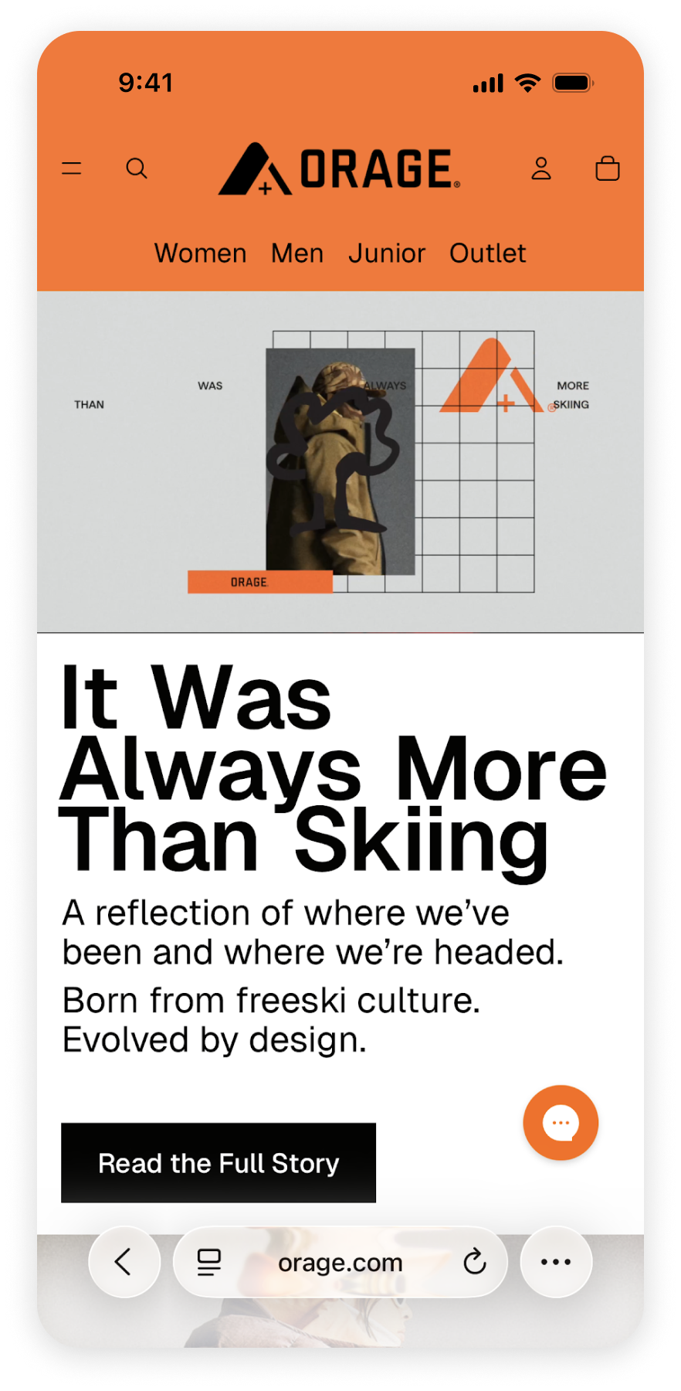
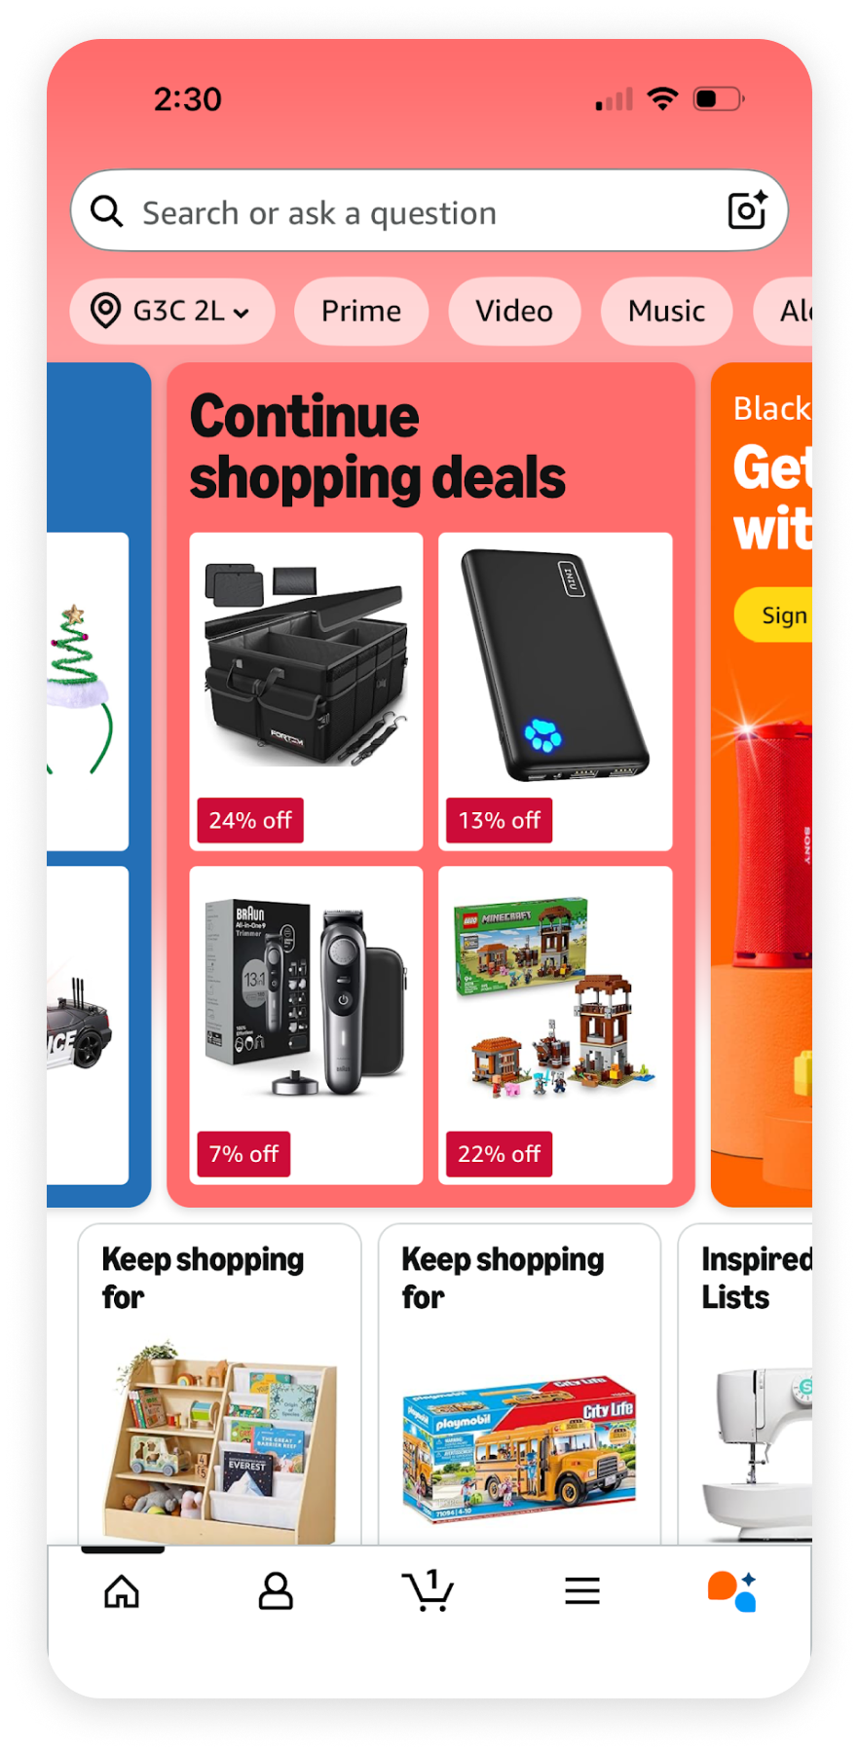
The SMB identity disadvantage
Independent retailers struggle to identify their buyers, degrading the experience: no personalization, lost carts, opaque shipping costs
Marketplaces have rich data and signed in users, perpetually furthering their advantage.

Slide 3
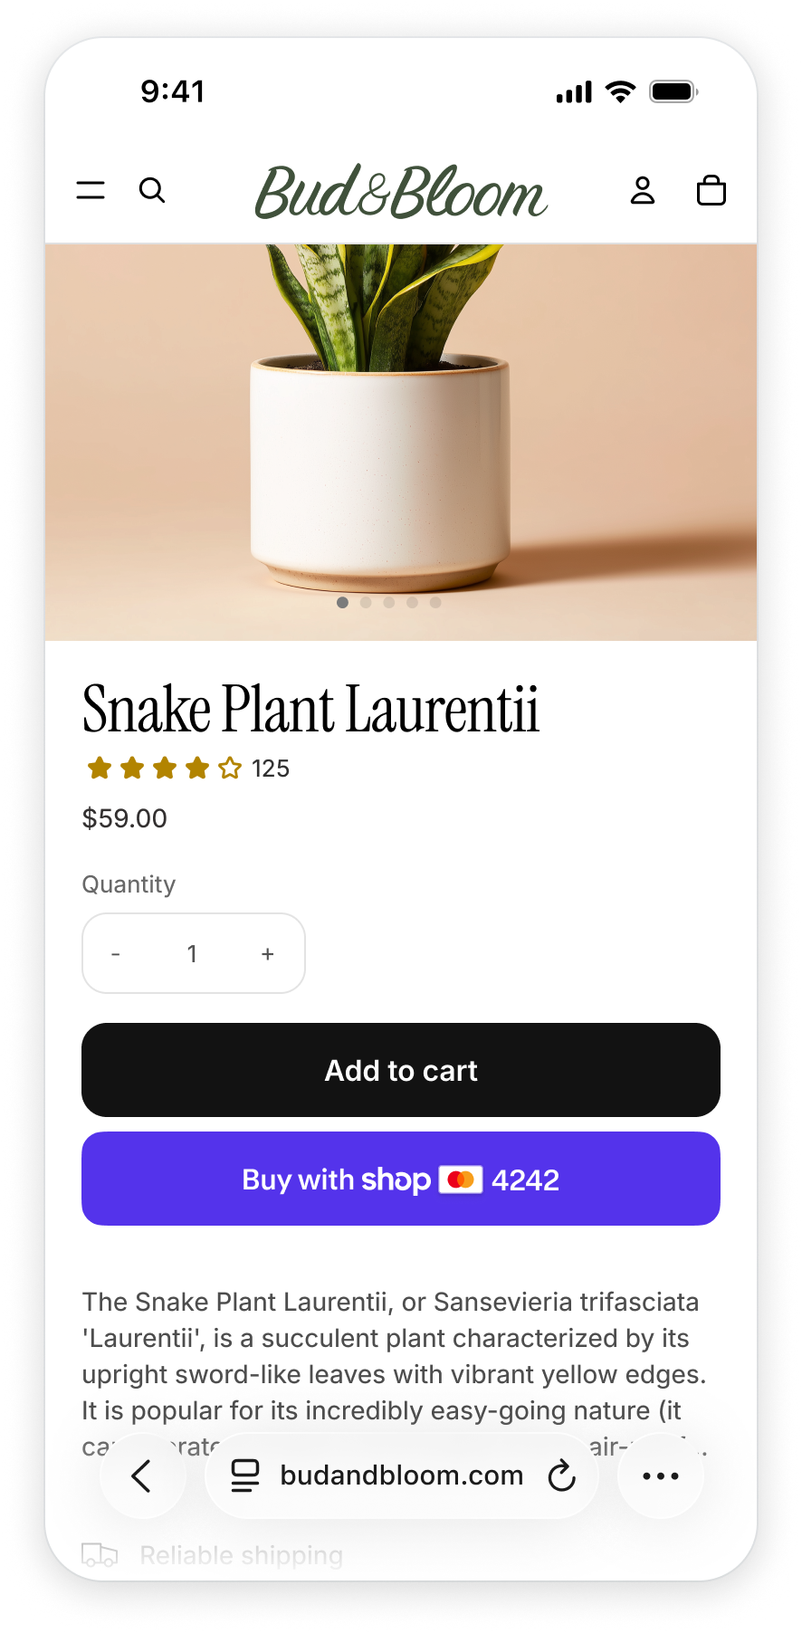
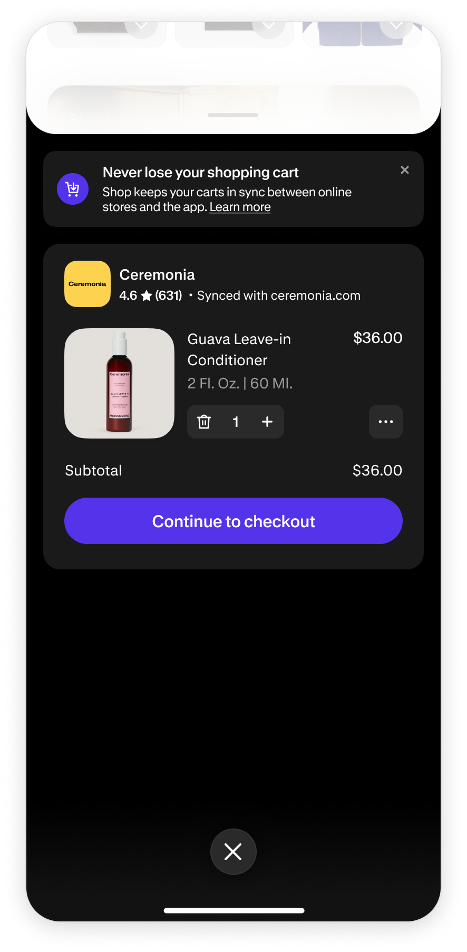
The 3P cookies approach
Effective where possible, but not widely available, privacy-preserving, or future-proof

Slide 4

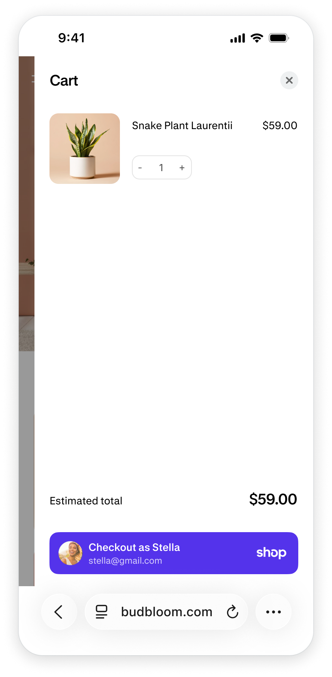
A better way with FedCM
Buyers take their shopping identity with them across the open web.
Privacy-preserving, 1-tap sign in seamlessly integrated in the shopping experience.

Slide 5
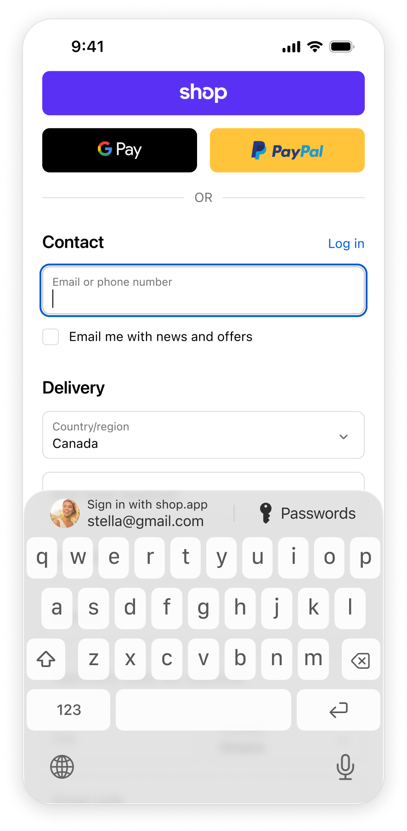
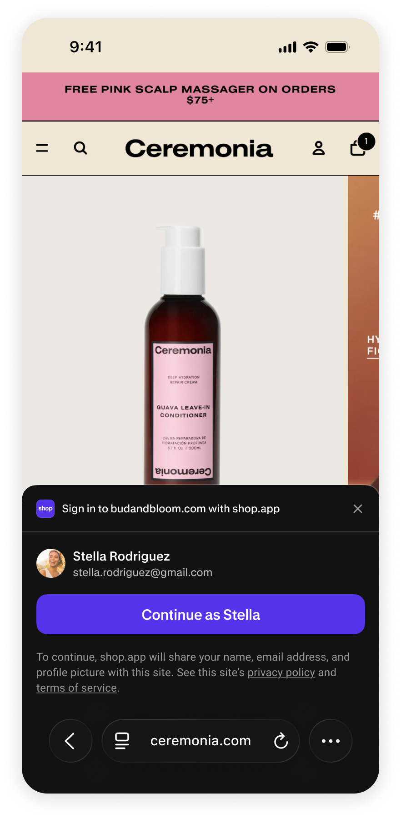
Other improvements
Input autofill
Modal UI
Theming
Multi-get
Better metrics over impressions

